Slide 1
Clean Code

Slide 2
Agenda
What’s Clean
Why is it important?
Clean Code

Slide 3

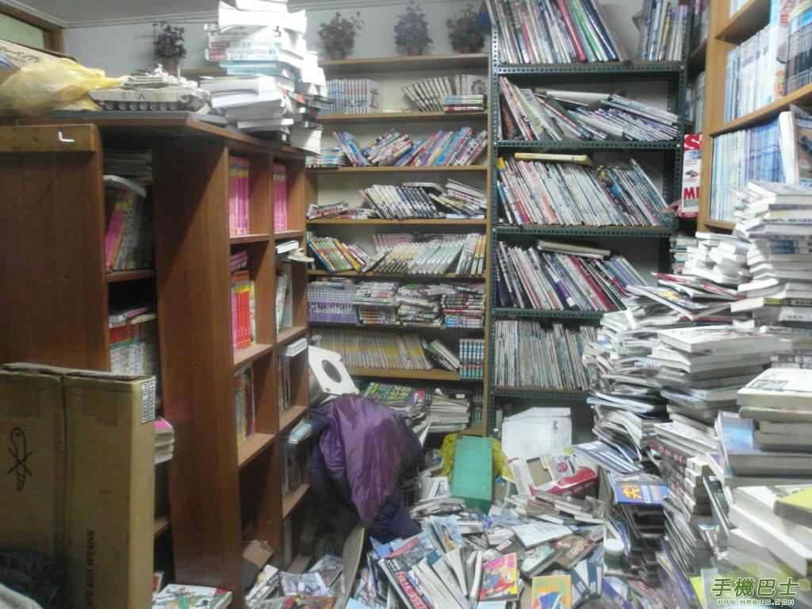
What’s the clean
Can you get the book what you want to read?

Slide 4
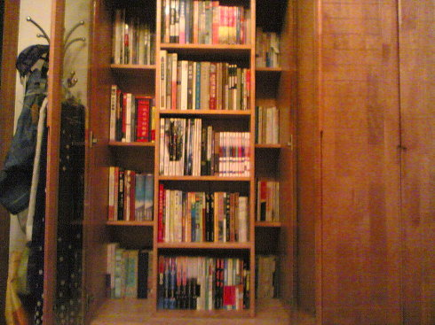
Can you get book what you want easily?

Slide 5
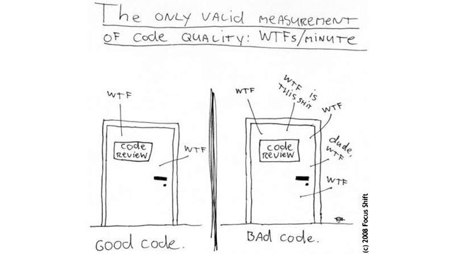
Clean Code
WTF

Slide 6
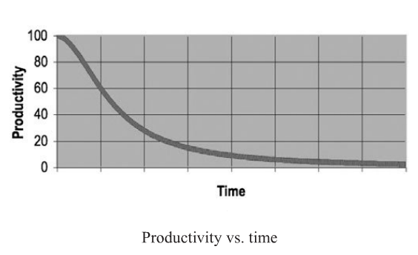
Productivity VS. Time

Slide 7
Clean code
Bjarne Stroustrup
I like my code to be elegant and efficient.
Grady Booch
Clean code is simple and direct. Clean code reads like will-written prose.
Dave Thomas
Clean code can be read, and enhanced by a developer other than its original author. It has meaningful names.

Slide 8
How to write clean codes
Name
Function
Comments
Formatting
Error Handling
Unit Tests

Slide 9
Name
Use Intention-Revealing Names
Avoid Disinformation
Make Meaningful Distinctions

Slide 10
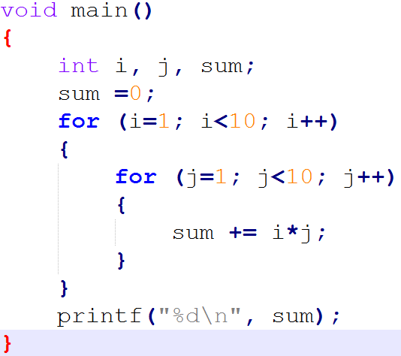
Use Intention-Revealing Names

Slide 11
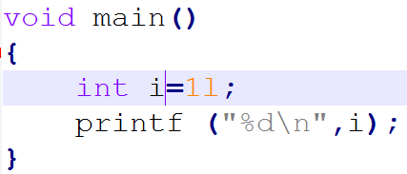
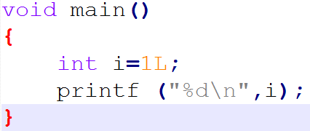
Avoid Disinformation

Slide 12
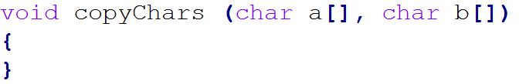
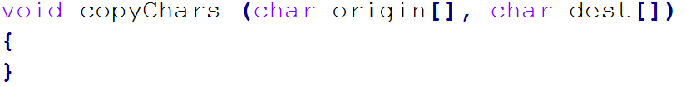
Make Meaningful Distinctions

Slide 13
Function
Small is important
Do one thing
One level of Abstraction per Function
Switch Statements
Function Arguments
Command Query Separation

Slide 14
Small is very important
??
Miller
The number of objects an average human can hold in working memory is 7±2

Slide 15
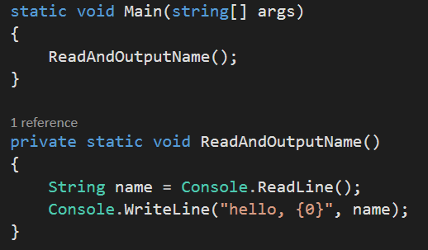
Do one thing
What need to be changed if user want to write out Age?
……..

Slide 16
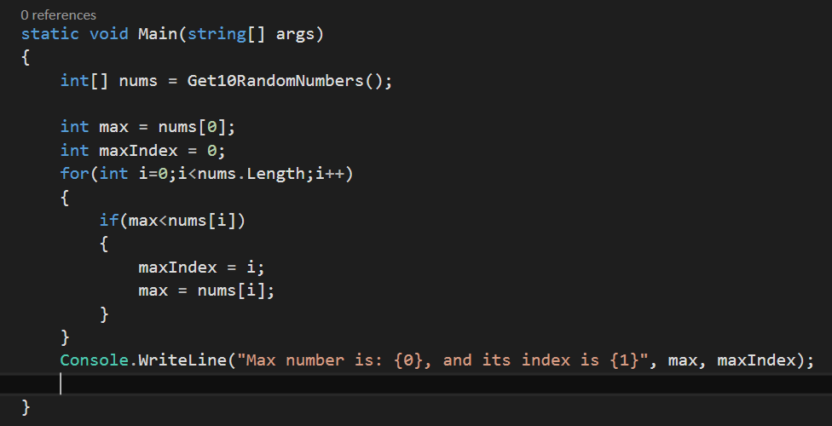
One level of Abstraction per Function

Slide 17
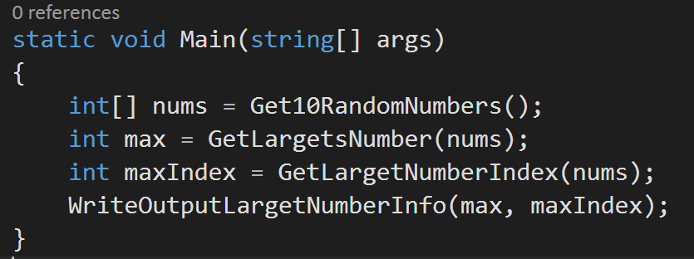
One level of Abstraction per Function

Slide 18
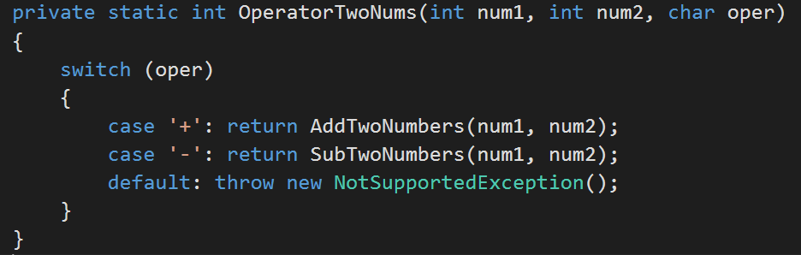
Switch Statements

Slide 19
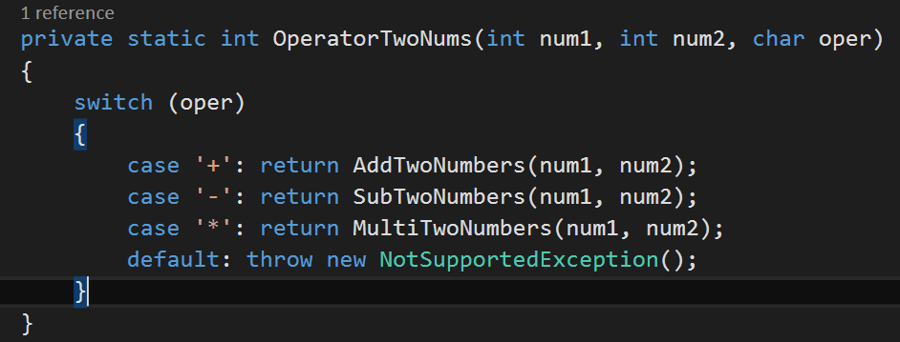
Switch Statements

Slide 20
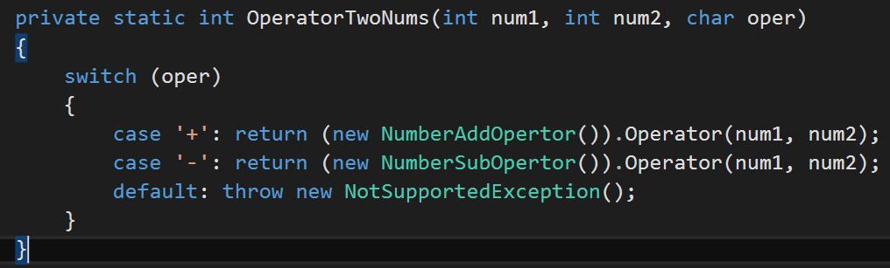
Switch Statements

Slide 21
Function Arguments
The ideal number of arguments for a function is zero. Next comes one, followed closely by two. Three arguments should be avoided where possible. More than three requires very special justification-and then shouldn’t be used anyway.

Slide 22
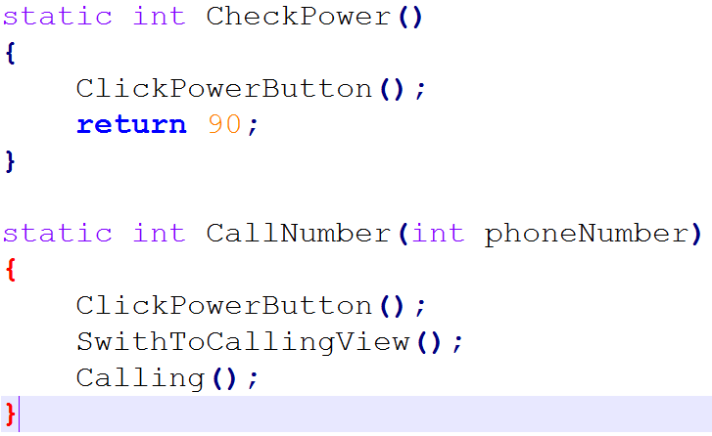
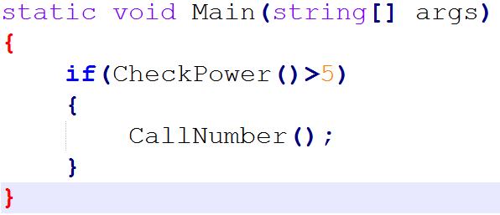
Command Query Separation
Function should either do something or answer something, but not both.

Slide 23
Comments
Comments do not make up for bad code
Bad comments:
Mumbling
Redundant Comment
Misleading Comment
Good comments:
Legal Comments
TODO Comments
Warning of Consequences

Slide 24
Error Handling
Use Exceptions Rather than Return Codes
Provide Context with Exceptions
Don’t return NULL

Slide 25
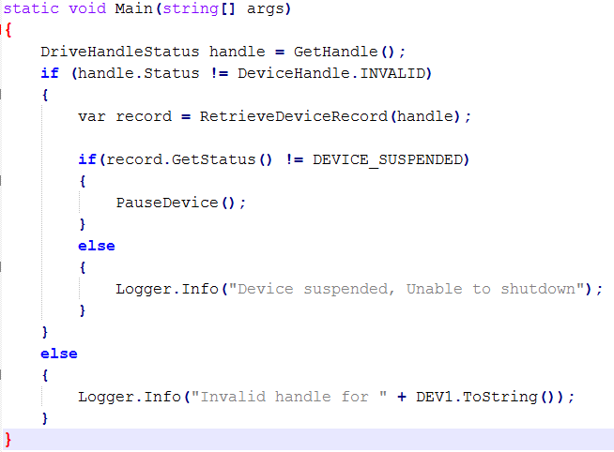
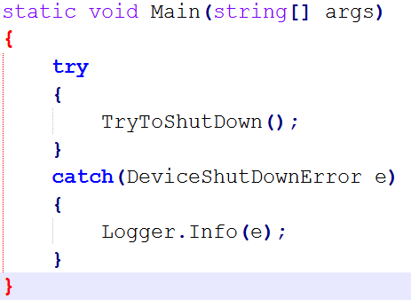
Use Exceptions Rather than Return Codes

Slide 26
Provide Context with Exceptions
Each exception should provide enough context to determine the source and location of an error.

Slide 27
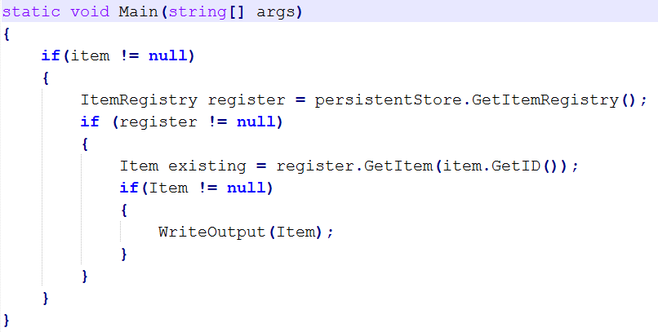
Don’t return NULL

Slide 28
Unit Tests
Tests are as important to the health of a project as the production code is.
F.I.R.S.T
Fast
Independent
Repeatable
Self-Validating
DEMO
MSTest

